Slide 1
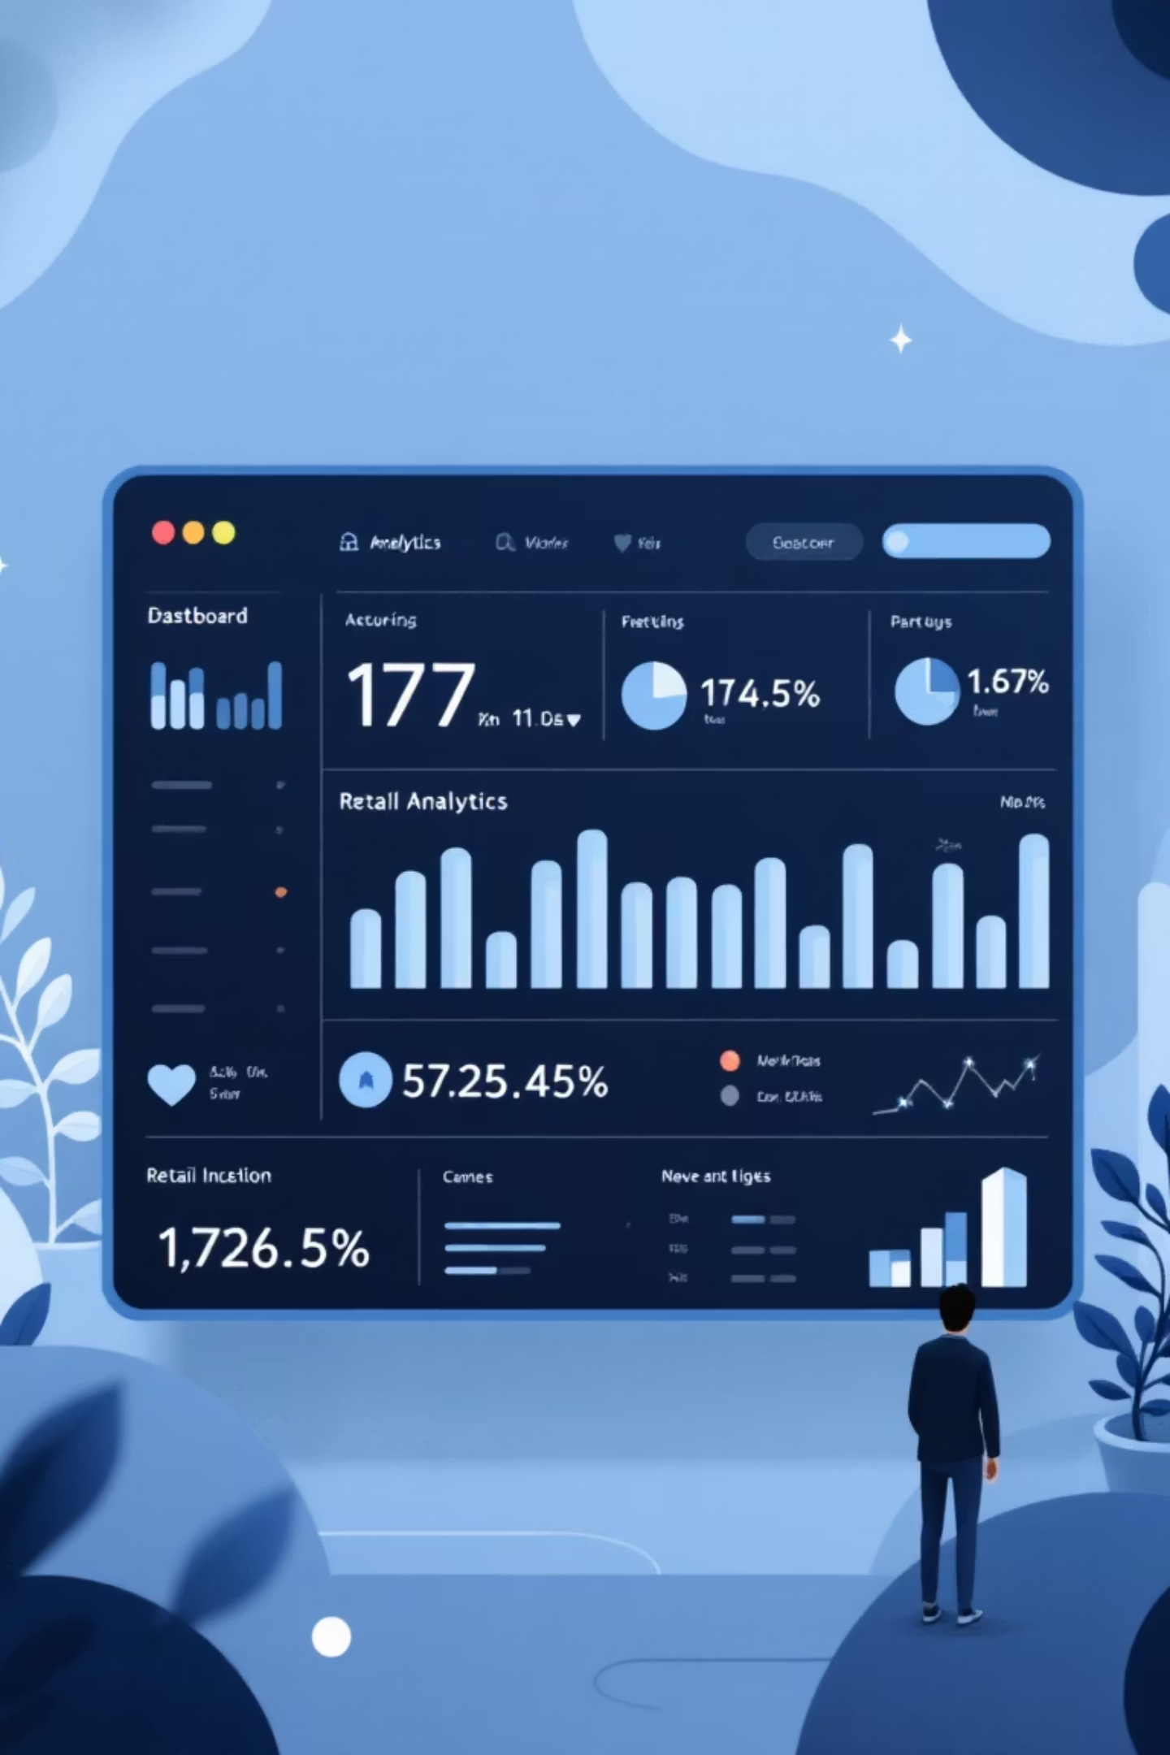
Customer Shopping Behavior Analysis
Uncovering insights from 3,900 purchases to guide strategic business decisions

Slide 2
Dataset Overview
3,900
18
37
Total Purchases
Data Points
Missing Values
Transactions analyzed
Features per transaction
In review ratings only
Demographics
Purchase Details
Shopping Behavior
Age, gender, location, subscription status
Item, category, amount, season, size, color
Discounts, promos, frequency, ratings, shipping

Slide 3


Data Preparation Process
01
02
03
Data Loading & Exploration
Missing Data Handling
Feature Engineering
Imported dataset using pandas, checked structure with df.info() and summary statistics
Imputed Review Rating nulls using median rating per product category
Created age_group bins and purchase_frequency_days columns
04
05
Data Consistency
Database Integration
Standardized columns to snake case, dropped redundant promo_code_used field
Connected to PostgreSQL and loaded cleaned data for SQL analysis

Slide 4
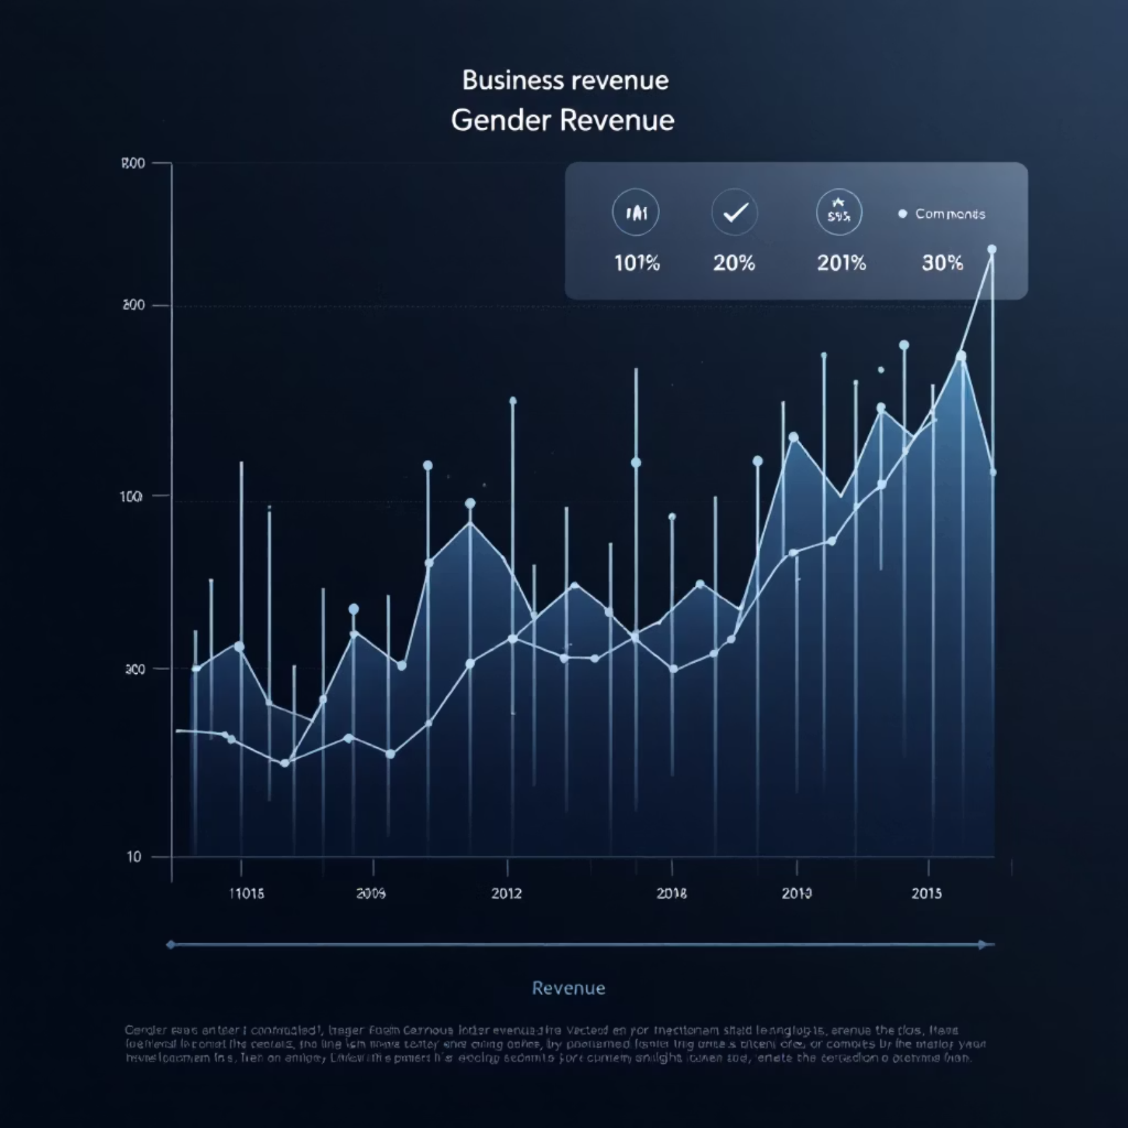
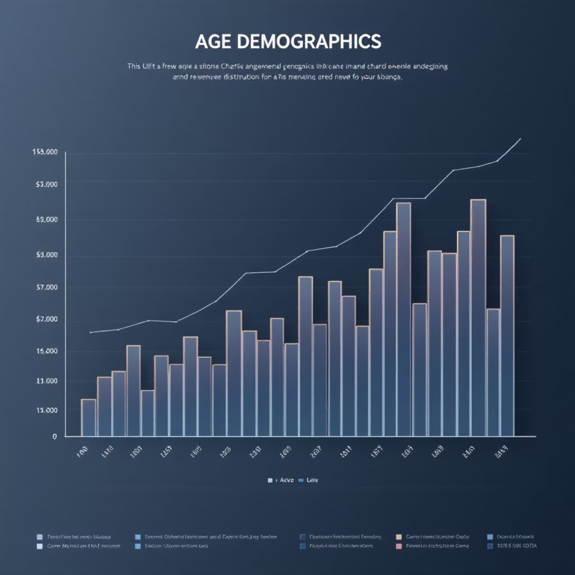
Revenue Insights
Revenue by Gender
Revenue by Age Group
Male customers generate slightly higher total revenue compared to female customers
Middle-aged customers (35-54) contribute the highest revenue share

Slide 5


Subscription Impact
68%
2.3x
Higher Average Spend
Revenue Multiplier
Subscribers spend more per transaction than non-subscribers
Total revenue from subscribers significantly outpaces non-subscribers
Customers with 5+ purchases show higher subscription rates, indicating loyalty correlation

Slide 6
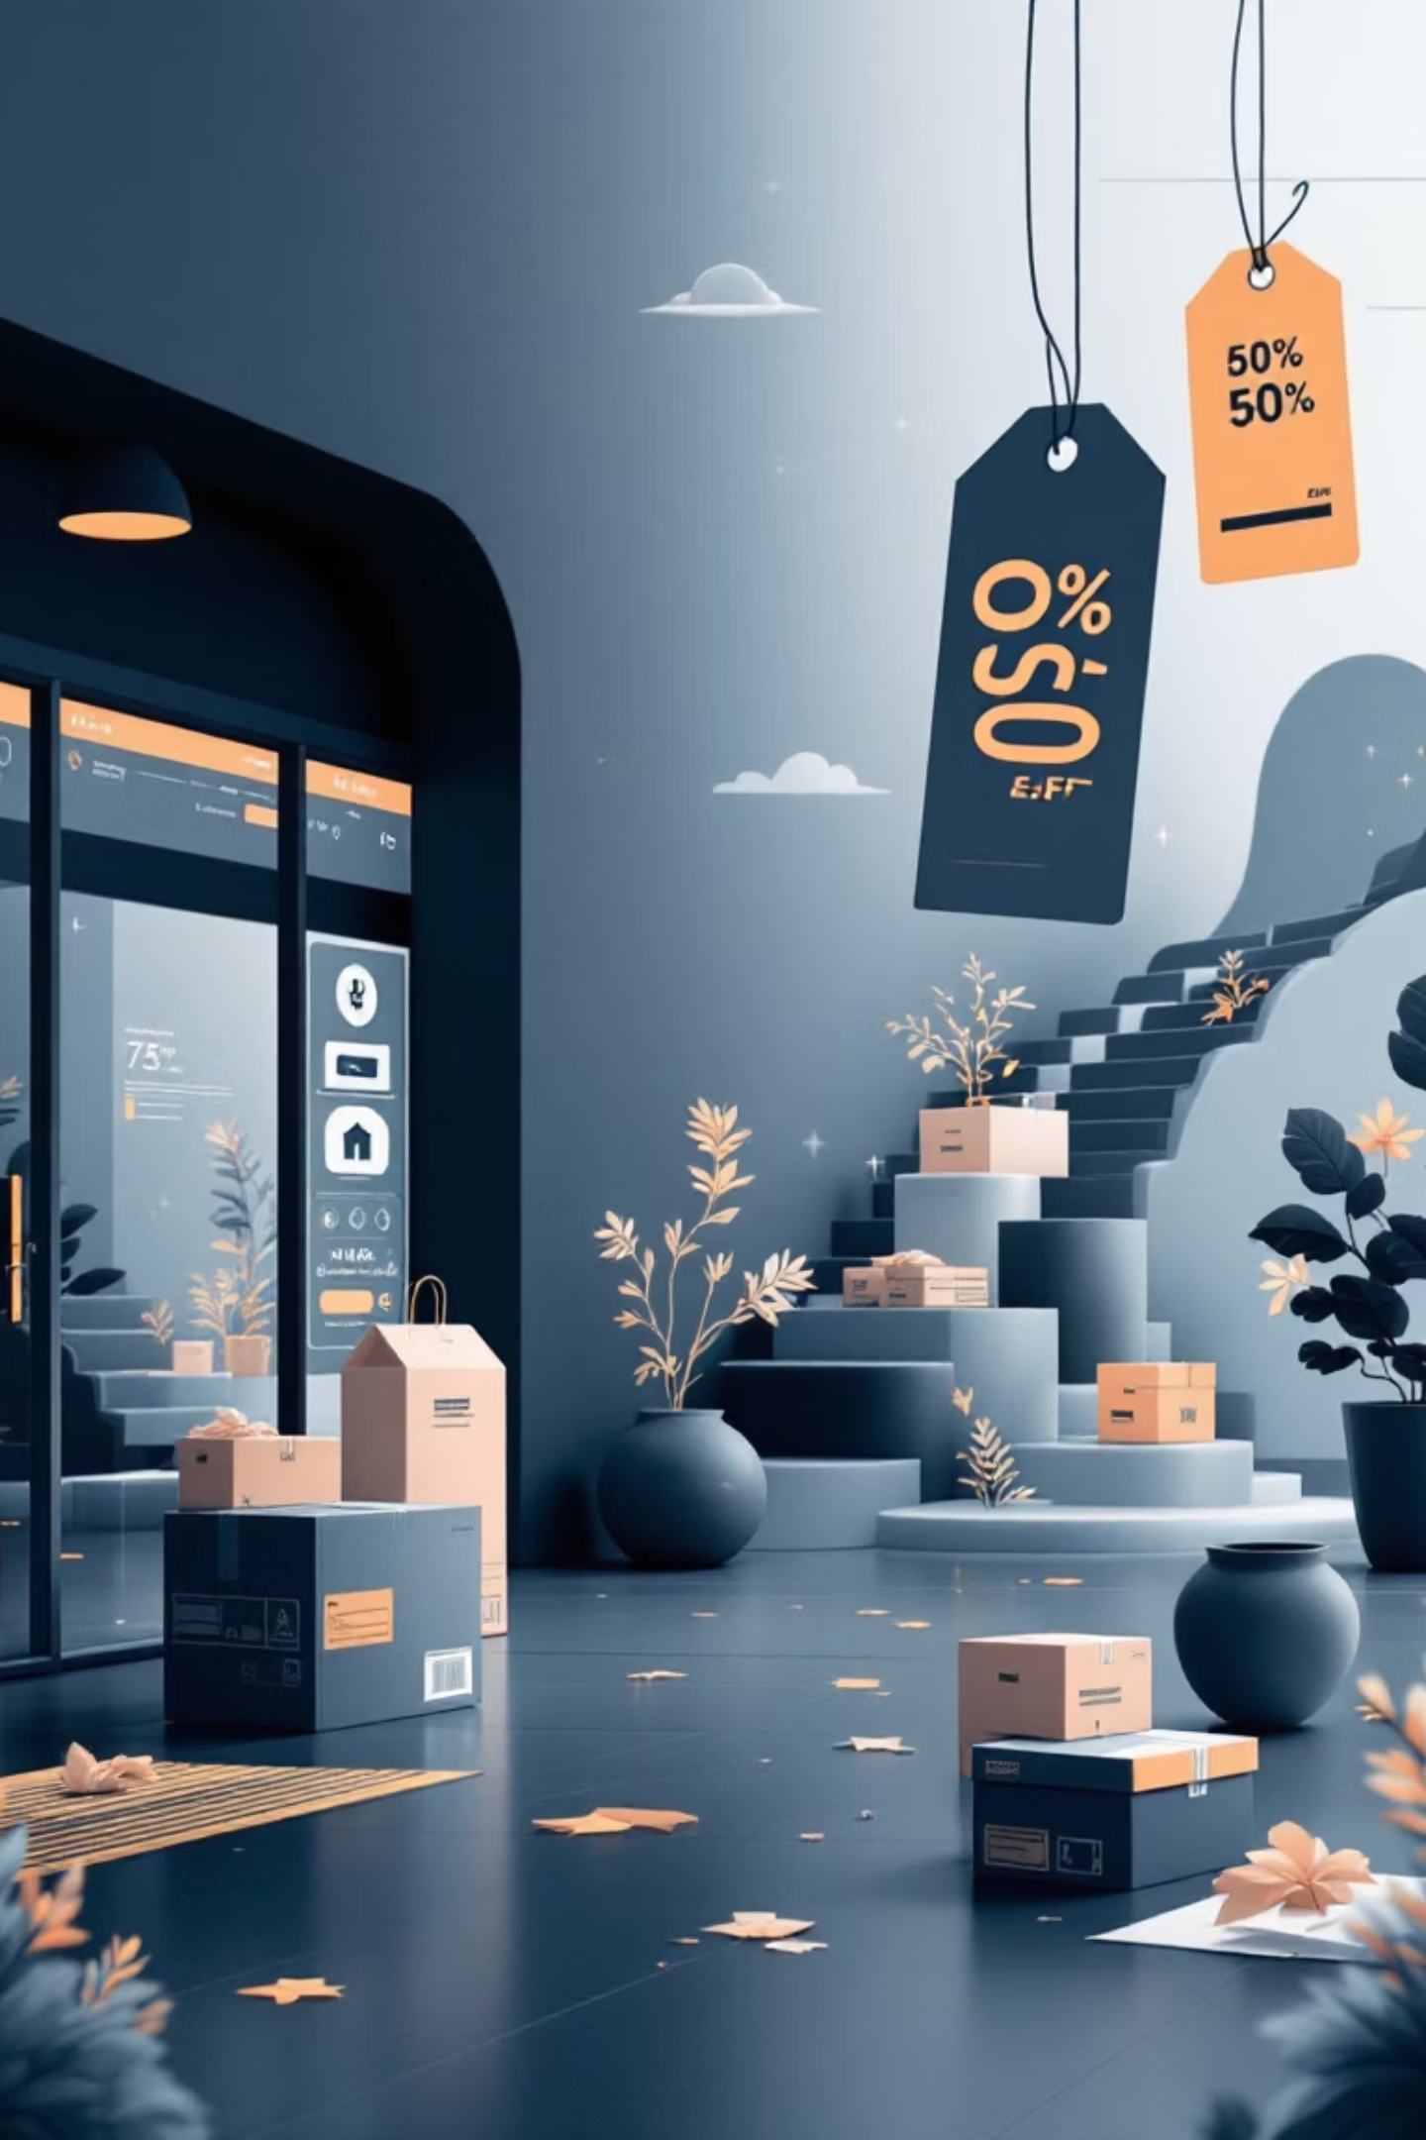
Discount & Shipping Patterns
High-Spending Discount Users
Discount-Dependent Products
Many customers using discounts still spend above average purchase amount
Top 5 products show 70-85% of purchases made with discounts applied
Shipping Type Comparison
Express shipping users spend 15% more on average than standard shipping customers

Slide 7
Top-Rated Products
Blouse
Dress
Sweater
Highest average rating: 4.8 stars
Consistently rated 4.7 stars
Customer favorite: 4.7 stars
Top-rated products show strong customer satisfaction and repeat purchase potential

Slide 8




Customer Segmentation
Loyal
Returning
New
Customers classified by purchase history: New (1-2 purchases), Returning (3-5), Loyal (6+)

Slide 9
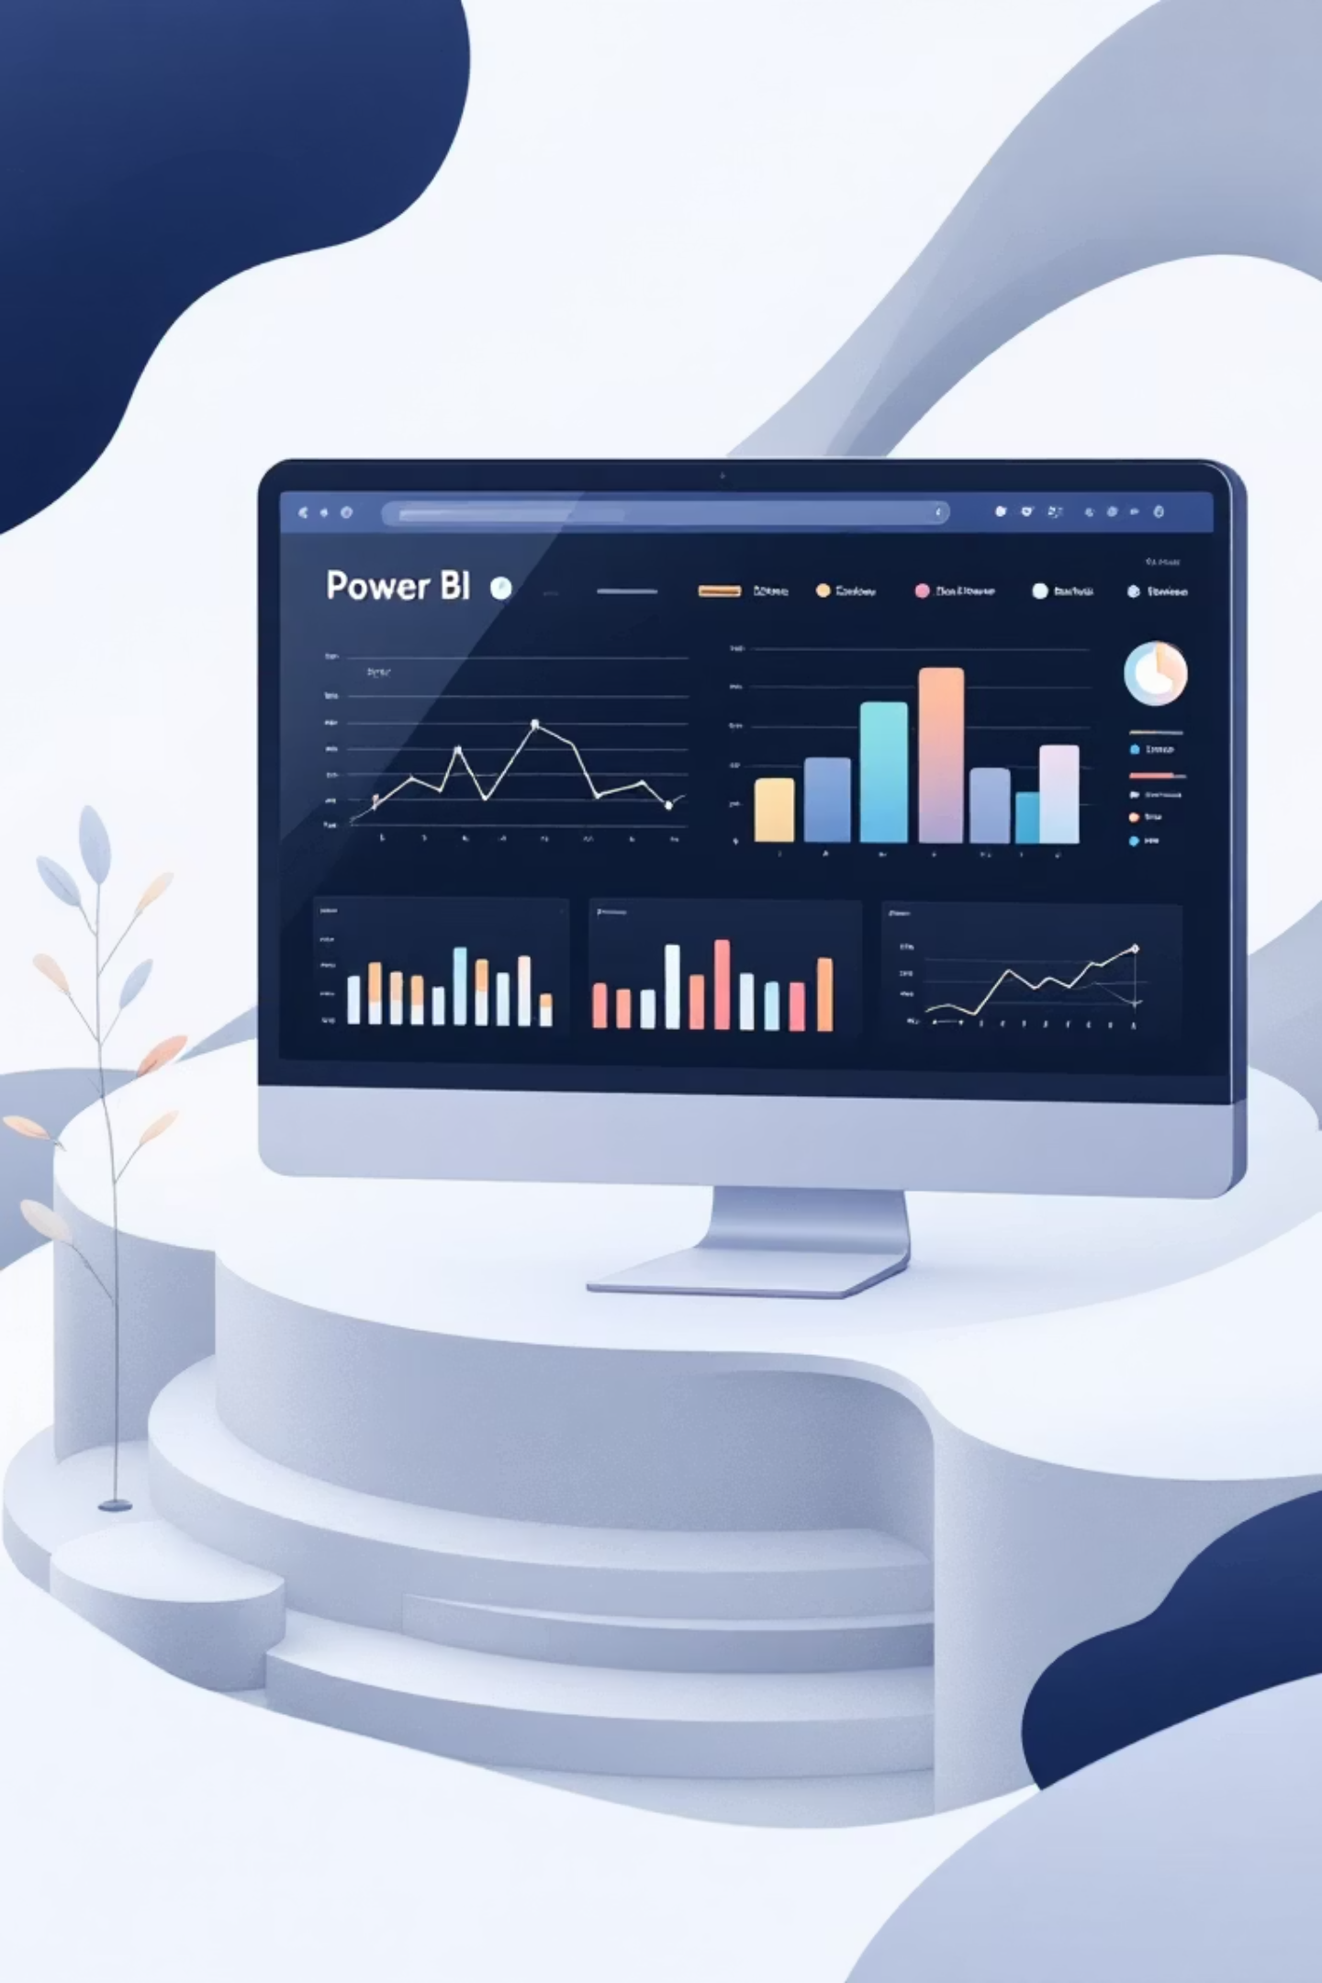
Interactive Dashboard
Visual Insights
Interactive Power BI dashboard presenting key metrics and trends
Real-Time Analysis
Dynamic filtering by category, demographics, and purchase behavior
Actionable Intelligence
Clear visualization of revenue drivers and customer segments

Slide 10





Strategic Recommendations
Boost Subscriptions
Promote exclusive benefits to convert high-frequency buyers
Loyalty Programs
Reward repeat buyers to move them into "Loyal" segment
Review Discount Policy
Balance sales boosts with margin control on discount-dependent products
Product Positioning
Highlight top-rated and best-selling items in marketing campaigns
Targeted Marketing
Focus on high-revenue age groups and express-shipping users

